Slide 1
HR Metrics & Analytics
Human Resource Report
by Daniel Buron
October 2024

Slide 2
Business Task
The primary business task is to conduct a comprehensive analysis of the company's workforce data to enhance organizational effectiveness and inclusivity.
Is there any relationship between who a person works for and their performance score?
What is the overall diversity profile of the organization?
What are our best recruiting sources if we want to ensure a diverse organization?
Can we predict who is going to terminate and who isn't? What level of accuracy can we achieve on this?
Are there areas of the company where pay is not equitable?

Slide 3
Descriptive Statistics
Metric | Value
Employees | 311
Positions | 30
Departments | 6
Median Salary | $62,810
Datapoints | 10,222
Dr. Carla Patalano and Dr. Rich Huebner are the original authors of this dataset. They provide a license to anyone who wishes to use this dataset for learning or teaching. For the purposes of sharing, please follow this license: CC-BY-NC-ND. This work is licensed under a Creative Commons Attribution-NonCommercial-NoDerivatives 4.0 International License.
All data assessed was downloaded from the following website: https://www.kaggle.com/datasets/rhuebner/human-resources-data-set/data.

Slide 4
DOCUMENTATION

Slide 5
Documentation: Cleaning
Missing Values Check
Initiate the data cleaning process by identifying missing values across the dataset using `is.na()` to ensure completeness.
Handling Missing and Duplicates
Remove rows with missing essential data (`ManagerName` and `PerformanceScore`) and duplicate entries based on `EmpID`.
Consistency in Categorical Data
Standardize and convert categorical columns (e.g., `GenderID`, `RaceDesc`, etc.) to factors to maintain consistency during analysis.
Outcome Inspection
Conclude the cleaning process by re-checking the dataset structure with `str()` to ensure no anomalies are present.
Ensuring Correct Data Types
Adjust data types of columns (`DOB` to Date) to facilitate accurate calculations, such as recalculating `Age` using consistent and correct date formats.

Slide 6
Documentation: Manipulation
Basic Data Overview
Employ functions like `str()`, `head()`, and `summary()` to explore the structure, initial entries, and statistical summary of the dataset.
Descriptive Statistics and Data Grouping
Use `dplyr` for summarizing data, such as median salary and distinct categories (e.g., department, position) with functions like `summarise()`.
Data Aggregation and Transformation
Manipulate the dataset to create new variables or adjust existing ones (e.g., creating a factor out of `PerformanceScore` to enable ordered comparisons).
Visualization
Generate plots using `ggplot2` to visually explore relationships and distributions, facilitating an intuitive understanding of the data (e.g., age distributions, salary comparisons).
Data Preparation for Analysis
Prepare cleaned and manipulated data for further statistical testing or machine learning applications by setting up factors, groups, and training/test datasets.

Slide 7
DIVERSITY

Slide 8
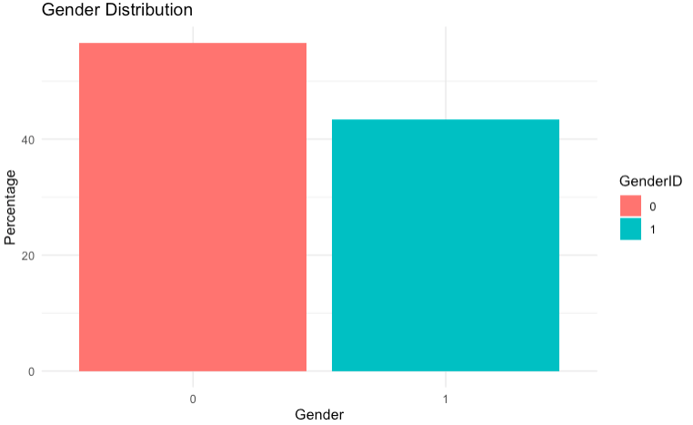
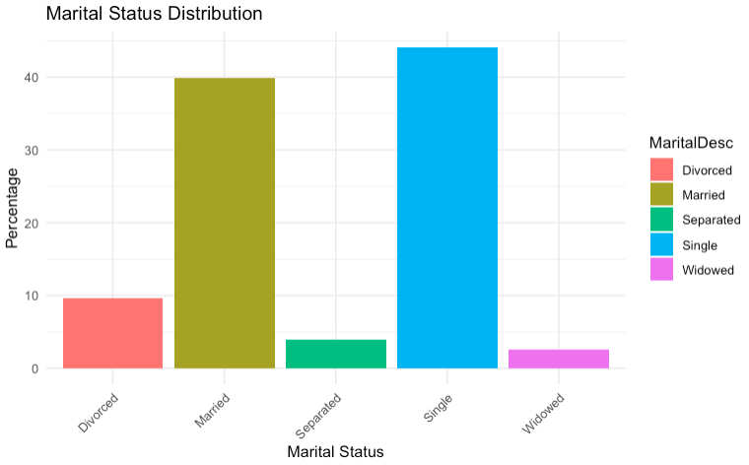
Diversity: Gender & Marital Status
What is the overall diversity profile of the organization?
Gender Diversity
The workforce is composed of approximately 43% (135) males (1) and 57% (176) females (0), which can contribute to diverse perspectives and more inclusive decision-making processes.
Marital Status Distribution
• The workforce shows a diverse range of marital statuses, with the majority of employees identifying as single (44.05%) or married (39.87%). This suggests a balanced representation of life stages within the organization, which can contribute to varied perspectives.
• With a notable percentage of employees being divorced (9.65%), separated (3.86%), or widowed (2.57%), there is an opportunity for the organization to consider tailored support programs that address the unique needs and challenges faced by these groups.

Slide 9
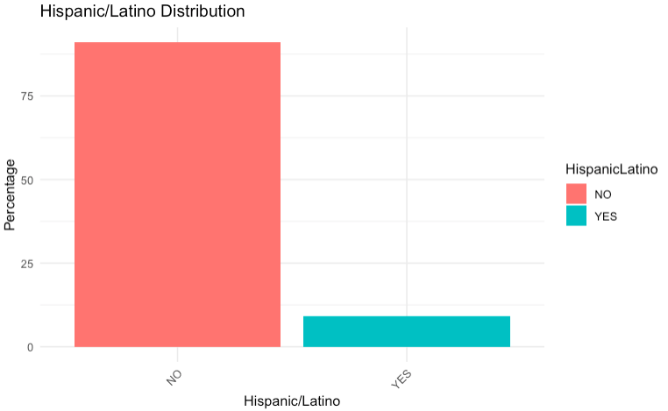
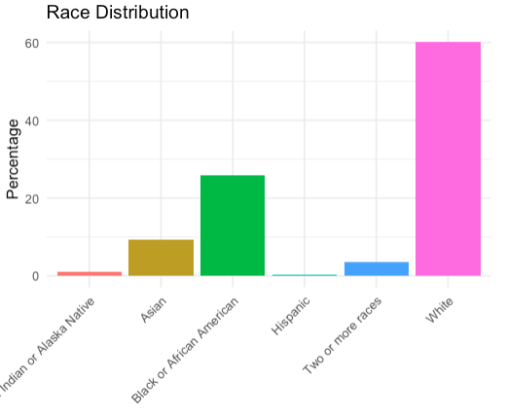
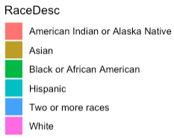
Diversity: Race & Hispanic Population
What is the overall diversity profile of the organization?
Hispanic/Latino Representation
Hispanic/Latino employees make up approximately 9% of the workforce, reflecting a relatively small but important part of the organization's diversity profile. This indicates potential areas for further development in representation and inclusion initiatives.
Racial/Ethnic Diversity
The organization shows a distribution of approximately 1% identifying as American Indian or Alaska Native, 9.3% as Asian, 25.7% as Black or African American, 3.5% as Two or more races, and 60.1% as White. There appears to be a significant representation of White employees, while other racial groups are less represented in the workforce.

Slide 10
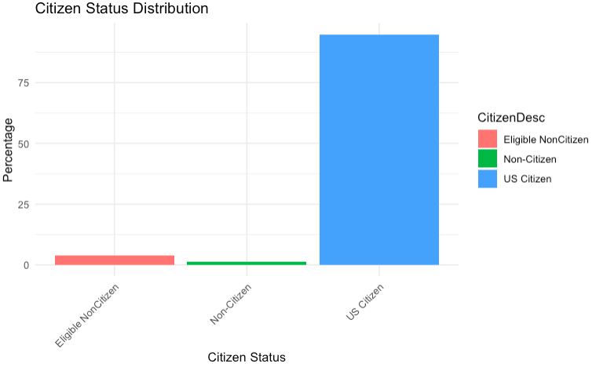
Diversity: Citizen Status
What is the overall diversity profile of the organization?
Citizen Status Overview
The organization's workforce is predominantly composed of US Citizens, comprising 94.86% of employees. Eligible Non-Citizens account for 3.86%, while Non-Citizens make up 1.29%. This highlights a strong representation of citizens, with limited diversity among non-citizen employees, presenting potential areas for expanding recruitment efforts to enhance international diversity.

Slide 11
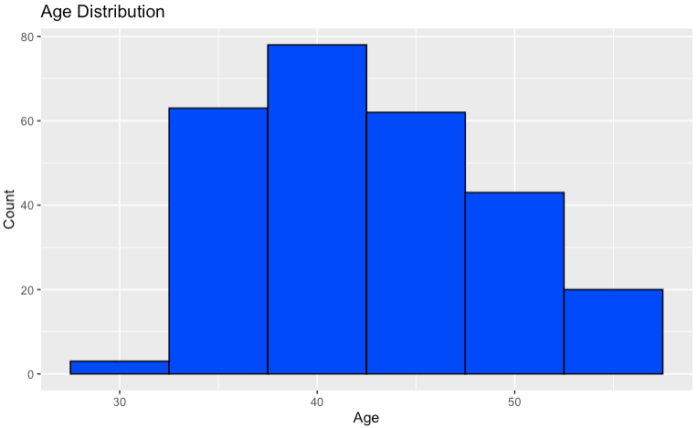
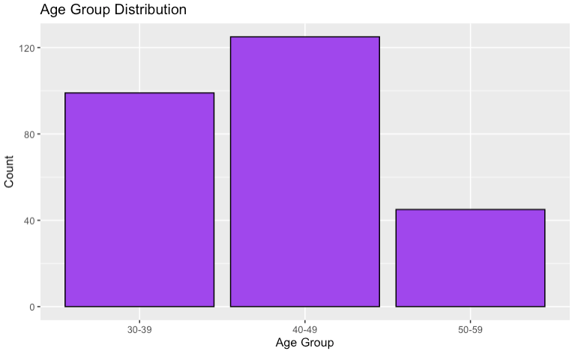
Diversity: Age
What is the overall diversity profile of the organization?
Age Distribution Insights
The histogram shows a detailed distribution of employee ages, revealing the spread and density of individual age groups from a minimum age of 32 and a maximum age of 55.
Age Group Overview
The bar plot categorizes employees into distinct age groups, highlighting a strong presence in the 30-39 (99 employees) and 40-49 (125 employees) brackets. A lower age representation is seen in the 50-59 age group (45 employees).

Slide 12
RECRUITING SOURCES

Slide 13
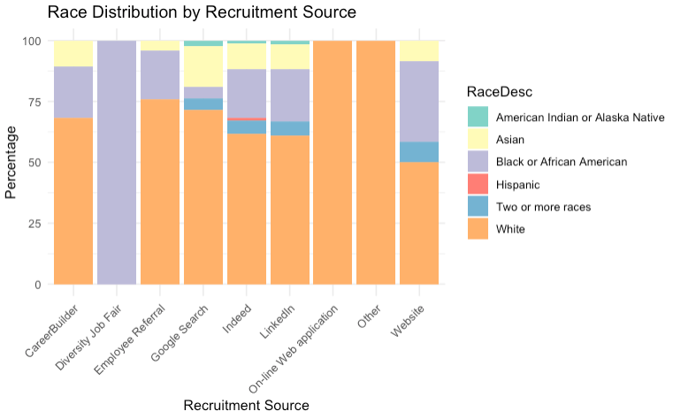
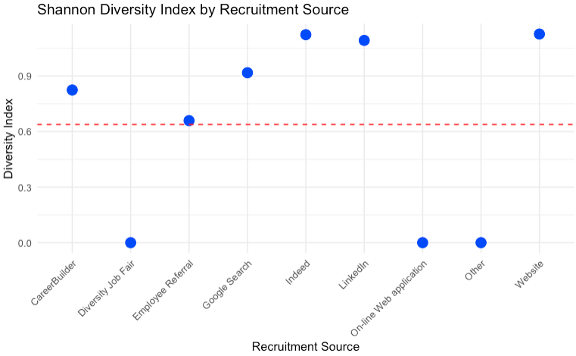
Recruiting Sources: Without Race Proportion Representation
What are our best recruiting sources if we want to ensure a diverse organization?
Understanding Shannon's Index
Shannon's diversity index is a measure that helps us understand how evenly different groups are represented in a dataset. A higher index means a more balanced mix, similar to an orchestra where all instruments are equally important, resulting in a harmonious performance.
Recruitment Source Diversity
• The results indicate that Indeed, LinkedIn, and Website are the most diverse recruitment sources, with Shannon diversity indices above 1, suggesting a more even distribution of racial categories.
• However, these results fail to include race proportion representation and requires a further analysis

Slide 14
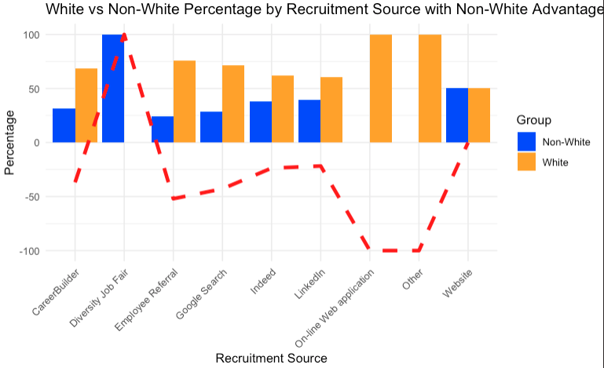
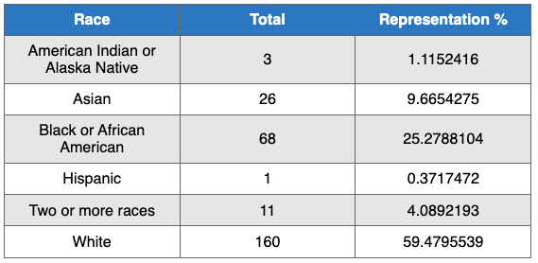
Recruiting Sources: Race Proportion Representation
What are our best recruiting sources if we want to ensure a diverse organization?
Current Workforce Representation
The organization's workforce is predominantly White, making up 59.48% of employees. Black or African American employees constitute 25.28%, while other racial groups—including Asian (9.67%), Two or More Races (4.09%), American Indian or Alaska Native (1.12%), and Hispanic (0.37%)—are significantly underrepresented. This highlights the critical need to focus recruitment efforts on increasing diversity among non-White groups to foster a more inclusive environment.
Recruitment Source Analysis
The Diversity Job Fair stands out as the most effective recruitment source for diversifying the workforce, with 100% of hires being non-White. Other platforms like LinkedIn and Indeed show a lower percentage of non-White hires compared to White hires. Emphasizing recruitment sources that have a positive non-white advantage can help address the current imbalance and promote a more diverse workforce composition.

Slide 15
EMPLOYEE SCORES VS MANAGERS

Slide 16
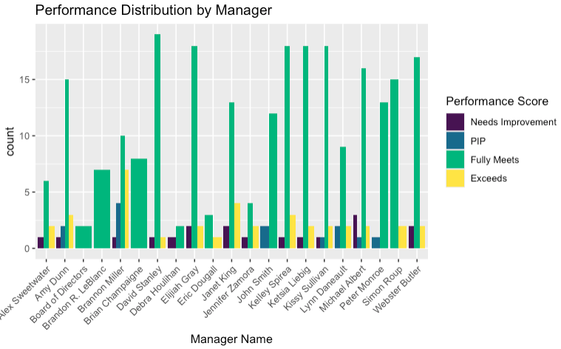
Employee Scores & Managers
Is there any relationship between who a person works for and their performance score?
Assessment of Manager Impact on Performance
The Kruskal-Wallis test indicates that there are no statistically significant differences in employee performance scores across different managers (p-value = 0.9734). This suggests that performance scores are generally consistent regardless of managerial oversight.
Implication
With a high p-value, we infer that variability in performance scores is not strongly associated with the individual manager, implying that other factors may have a more substantial impact on employee performance.
Recommendations for Further Exploration
Given these findings, we recommend exploring additional variables that may influence performance outcomes, such as team dynamics, workload, or professional development opportunities, to gain a more comprehensive understanding of performance determinants within the organization.

Slide 17
Equitable Pay

Slide 18
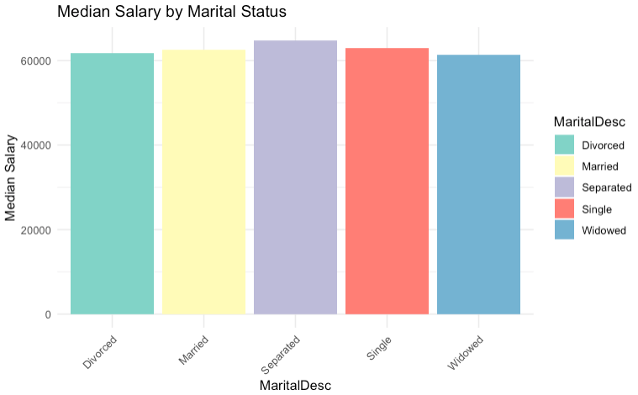
Equitable Pay: No Significance
Are there areas of the company where pay is not equitable?
t-test for GenderID
t = -1.2088, p-value = 0.2279, suggesting no statistically significant difference in salaries between genders.
ANOVA for MaritalDesc
F value = 2.0868, p-value = 0.1055, indicating no statistically significant difference in mean salaries across different marital status (at the 0.05 significance level).
ANOVA for CitizenDesc
F value = 0.34755, p-value = 0.7196, indicating no statistically significant difference in mean salaries across different marital status (at the 0.05 significance level).

Slide 19
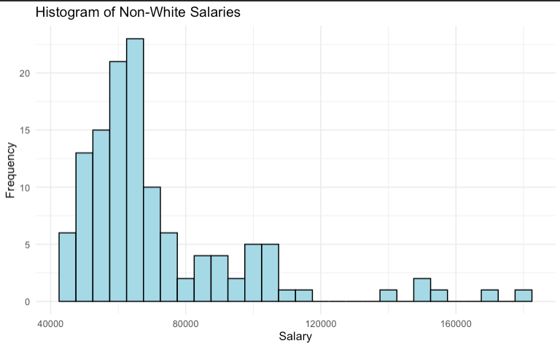
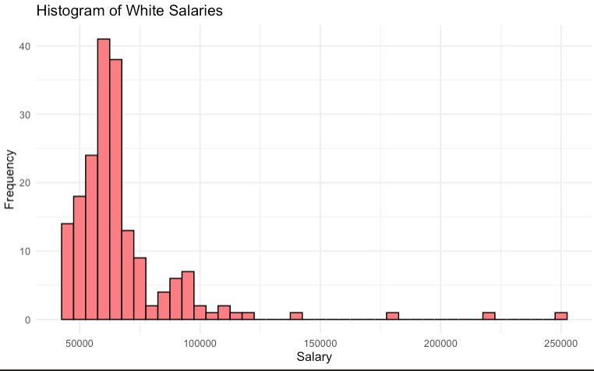
Equitable Pay: No Significance
Are there areas of the company where pay is not equitable?
Focus
The salary comparison between White and Non-White employee groups was conducted due to the higher proportion of White employees within the organization.
Initial Findings
The initial Welch Two Sample t-test indicated no statistically significant difference in mean salaries between Non-White and White employees (p-value = 0.05369). The average salary for Non-White employees was $71,619.84, while White employees earned $65,941.03. Although there was a numerical difference favoring Non-White employees, the p-value was slightly above the conventional threshold of 0.05, suggesting the results weren't statistically significant. Next Steps Investigate Possible Outliers

Slide 20
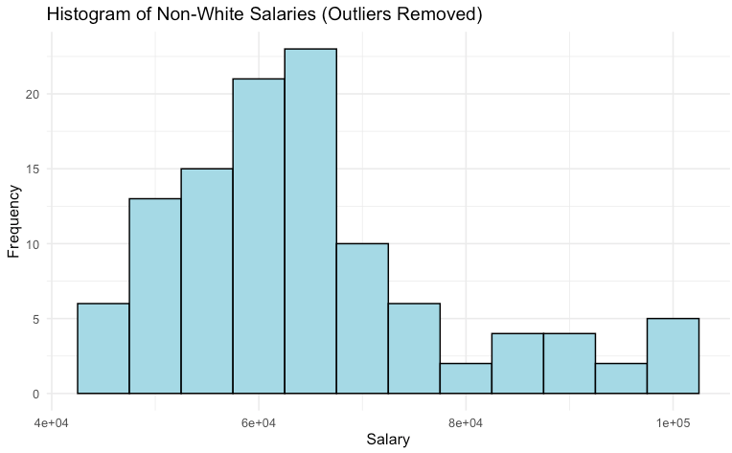
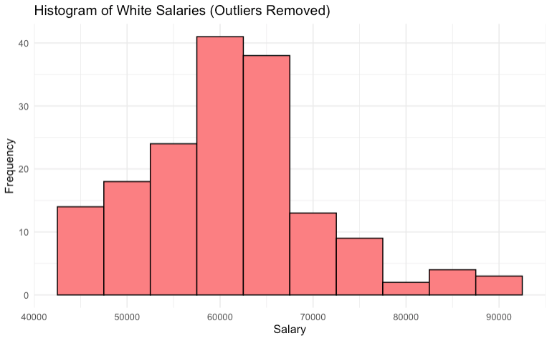
Equitable Pay: IQR Outliers
Are there areas of the company where pay is not equitable?
Calculate IQR for Each Group*
White Salaries
- Compute summary statistics and interquartile range (IQR) for white salaries.
- Determine outlier boundaries using the IQR method:
- Lower bound: 1st quartile - 1.5 * IQR.
- Upper bound: 3rd quartile + 1.5 * IQR.
Non-White Salaries
- Similarly, calculate summary statistics and IQR for non-white salaries.
- Establish outlier limits using the same 1.5 * IQR rule for this group.
Filter Outliers
For both white and non-white salaries, filter the data to exclude values outside of the calculated bounds, effectively removing outliers from each set.

Slide 21
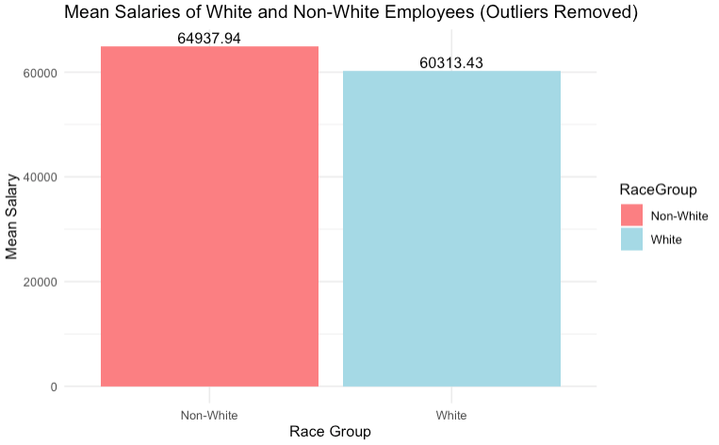
Equitable Pay: Significant
Are there areas of the company where pay is not equitable?
Focus
The salary comparison between White and Non-White employee groups was conducted due to the higher proportion of White employees within the organization.
Initial Findings
The initial Welch Two Sample t-test indicated no statistically significant difference in mean salaries between Non-White and White employees (p-value = 0.05369). The average salary for Non-White employees was $71,619.84, while White employees earned $65,941.03. Although there was a numerical difference favoring Non-White employees, the p-value was slightly above the conventional threshold of 0.05, suggesting the results weren't statistically significant.
Further Analysis Post-Outlier Removal
A further analysis was conducted to assess the impact of outliers on salary distribution. After removing outliers, a subsequent Welch Two Sample t-test revealed a statistically significant difference in mean salaries (p-value = 0.004528). This analysis showed that Non-White employees had an average salary of $64,937.94, compared to $60,313.43 for White employees. The confidence interval (1454.54 to 7794.48) confirmed a meaningful difference.
Further Investigation Needed
The removal of outliers clarified disparities, highlighting the importance of considering salary distribution nuances. These findings suggest potential areas for further exploration and targeted interventions to ensure equitable compensation across all racial groups within the organization.

Slide 22
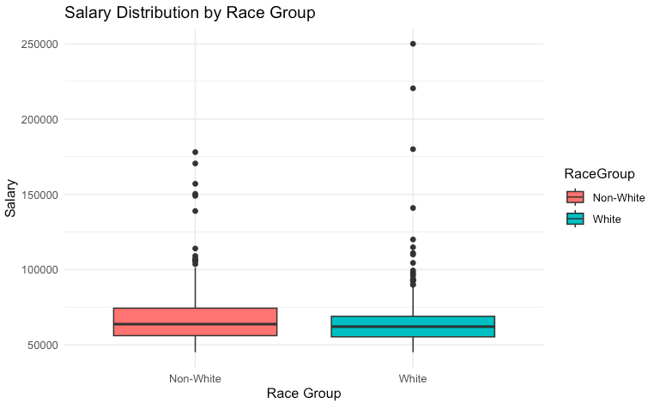
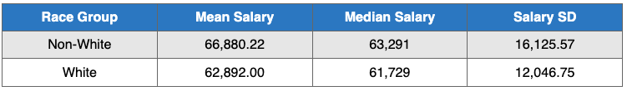
Equitable Pay: Other Methods
Are there areas of the company where pay is not equitable?
Winsorized
data: Salary by RaceGroup t = 1.7956, df = 309, p-value = 0.07354
Box Cox
data: Salary by RaceGroup t = 1.7939, df = 309, p-value = 0.07381 Remove the top 5% of salaries
data: Salary by RaceGroup t = 2.4234, df = 292, p-value = 0.01598
Cutoff of Salaries Less Than 16,000
data: Salary by RaceGroup t = 1.495, df = 309, p-value = 0.1359
Cutoff of Salaries Less Than 15,000
data: Salary by RaceGroup t = 1.495, df = 309, p-value = 0.1359
Cutoff of Salaries Less Than 12,000
data: Salary by RaceGroup t = 1.495, df = 309, p-value = 0.1359
Interpretation of Results: Remove the top 5% of salaries
- The test indicates a statistically significant difference between the mean salaries of non-white and white groups (p-value = 0.01598).
- The 95% confidence interval for the difference in means suggests that non-white salaries are between \$749 and \$7227 higher than white salaries, on average.

Slide 23
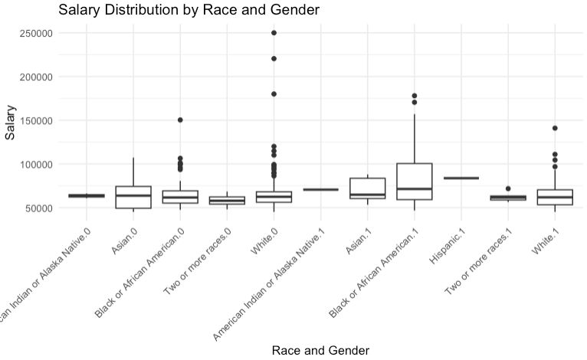
Equitable Pay: Intersection Analysis
Are there areas of the company where pay is not equitable?
Data Exploration / ANOVA Exploration
Position, Gender, and Salary
Department, Gender, and Salary
Position, Race, and Salary
Findings
Position has a highly significant impact on salary (p-value less than 2 * 10^-16). While significant, the researcher decided to prioritize other factors than position and salary.
Race, Gender, and Salary
Grouped data by race and gender to compute summary statistics including mean salary, median salary, and count of individuals in each group.
ANOVA Analysis
Conducted a two-way ANOVA to examine the effects of race, gender, and their interaction on salary.
- Race: Not a statistically significant factor by itself (F(5) = 1.313, p = 0.2581).
- Gender: Not a statistically significant factor by itself (F(1) = 1.053, p = 0.3057).
- Interaction effect (Race:Gender): Statistically significant (F(4) = 2.592, p = 0.0368).

Slide 24
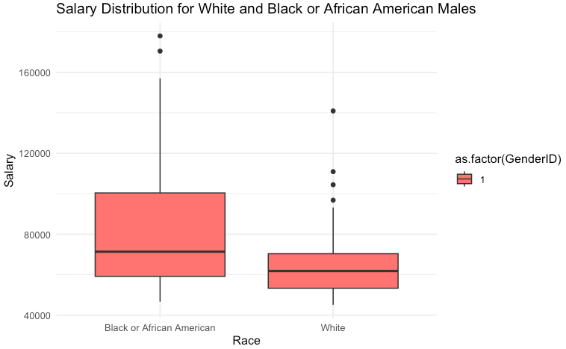
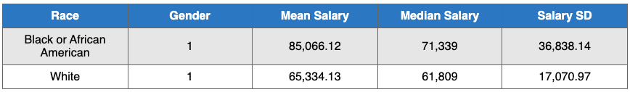
Equitable Pay: Intersection Analysis
Are there areas of the company where pay is not equitable?
Post-hoc Analysis
Employed Tukey's Honest Significant Difference (HSD) test for pairwise comparisons between race-gender groups.
Significant finding
The salary difference between White males and Black or African American males is significant, with a p-value of 0.0075776 and a confidence interval that does not include zero.
Focused Comparison
- Analyzed and summarized salary data specifically for White males and Black or African American males:
- Computed summary statistics (mean, median, standard deviation) for these groups.
White:1 - Black or African American:1 This is one of the few comparisons with a significant p-value (0.0075776), suggesting that there is a significant difference in salary between these groups. The confidence interval does not include zero, confirming a meaningful difference.

Slide 25
PREDICTING TERMINATION

Slide 26
Predicting Termination: Attempt 1
Can we predict who is going to terminate and who isn't? What level of accuracy can we achieve on this?
Initial Data Preparation
- Utilized variables such as Age, Salary, DeptID, PerfScoreID, and Absences.
Categorical variables were encoded where necessary; data was split into training and testing sets.
First Model (Full Factors)
- Model Type: Logistic Regression with all selected factors.
Key Metric: Accuracy of 64.15%, with significant sensitivity (88.89%) but low specificity (11.76%).
Refinement Based on Significance
- Only "Absences" was statistically significant in predicting termination.
A simplified model was created using only Absences as the predictor.
Second Model (Absences Only)
- Model Type: Logistic Regression with Absences as the sole factor.
- Key Metric: Accuracy of 67.92%, achieving perfect sensitivity (100%) but with no ability to correctly predict non-terminations (0% specificity).
Essential Metrics
First Model:
- Sensitivity: 88.89%
- Specificity: 11.76%
Kappa: 0.0079
Conclusion
- First Model: Better for predicting terminations but poor at non-terminations.
- Second Model: High sensitivity with no specificity—predicts all as terminated.
- Neither model reached satisfactory performance levels.
Recommendations
1. Feature Engineering: Explore additional variables or derived metrics, such as work performance trends, engagement scores, or interactions between variables.
2. Advanced Modeling: Implement machine learning techniques such as decision trees, random forests, or gradient boosting to capture complex patterns.
3. Data Enrichment: Collect more diverse data points, perhaps including qualitative measures from employee surveys or exit interviews.
4. Cross-Validation: Use robust cross-validation techniques to better assess model stability and performance across different samples.
Second Model:
- Sensitivity: 100%
- Specificity: 0%
- Kappa: 0

Slide 27
Predicting Termination: Attempt 2 “Prep”
Can we predict who is going to terminate and who isn't? What level of accuracy can we achieve on this?
Data Cleaning
- Removed duplicates based on `EmpID`.
- Converted non-numeric variables to factors for modeling readiness.
- Handling Missing Values:
• Filled missing `ManagerID` using the most frequent ID for each `ManagerName`.
• Addressed NAs in `DateofTermination` by substituting with a reference date for active employees.
Feature Engineering
Age and Tenure: Engineered `Age` from `DOB` and calculated `Tenure` for both active and terminated employees.
Data Transformation
- Selection of Features: Excluded identifiers and less predictive variables (e.g., `Employee_Name`, `EmpID`).
- Scaling: Scaled numerical features for improved model performance.

Slide 28
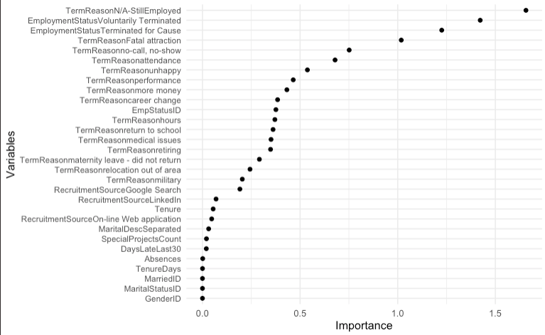
Predicting Termination: Attempt 2
Can we predict who is going to terminate and who isn't? What level of accuracy can we achieve on this?
Modeling
- Predictive Modeling: Employed `glmnet` (Lasso/Ridge regression) with cross-validation for predicting termination (`Termd`).
- Model Evaluation: Achieved perfect accuracy on test data, suggesting potential overfitting.
Findings
- Predictive Capability: The model demonstrated a high ability to correctly predict termination status with 100% accuracy on the test dataset.
- Concerns of Overfitting: Perfect accuracy indicates a risk of overfitting. Further validation with unseen data is recommended.
- Visual Insights: Generated variable importance plots to highlight key features impacting predictions.
Recommendations
- Model Validation: Validate on external data to ensure generalizability.
- Feature Review: Consider refining features and exploration of potential overfit areas in the model.
- Continuous Monitoring: Keep track of model performance over time, especially if applied in a real-world setting.

Slide 29
CONCLUSION

Slide 30
Conclusion
Relationship Between Manager and Performance Score
The analysis using the Kruskal-Wallis test demonstrates no significant relationship between managerial oversight and employee performance scores. This finding suggests that managerial differences may not substantially impact performance, directing attention to other potentially influencing factors such as team dynamics or developmental opportunities.
Overall Diversity Profile
- Gender and Marital Diversity: With a near balance between male and female employees and varied marital status representation, the organization shows a relatively diverse workforce in terms of gender and life stages.
- Racial/Ethnic Diversity: While the workforce has significant White representation, there are opportunities to enhance ethnic diversity. Hispanic/Latino employees form a small portion, offering potential for growth in this area.
- Citizenship: The workforce is predominantly U.S. citizens, with minimal diversity from international or non-citizen employees, presenting an opportunity to broaden recruitment to include more global talent.
- Age Diversity: A strong presence of employees in the 30-49 age brackets indicates a need to balance age distribution for future diversity and perspective inclusion.
Diverse Recruitment Sources
- While Indeed, LinkedIn, and the company Website show potential for enhancing diversity, the workforce is still predominantly White (59.48%). This underscores the necessity for focused efforts to diversify beyond just these channels.
- The Diversity Job Fair stands out with 100% of hires being non-White, making it the most effective channel for diversifying the workforce. Conversely, LinkedIn and Indeed have lower proportions of non-White hires.
- Emphasizing recruitment sources like Diversity Job Fairs, which have shown a strong non-White hiring advantage, could effectively correct current imbalances and foster a more inclusive workforce.
Predicting Employee Termination
Although models were developed, further refinement is necessary to accurately predict which employees might terminate. Absence was considered as a single predictor but should be integrated with other variables for improved prediction accuracy. Termination reasons proved to be important variables in early testing.
Equity in Compensation
Initial findings showed no significant salary disparity between racial groups, but deeper analysis post-outlier removal revealed significant differences that possibly favored Non-White employees. This suggests a need for further investigation into other intersections (eg. Position, tenure, etc) and nuanced evaluation of compensation practices to ensure fairness and inform policy adjustments.

